Slide 1

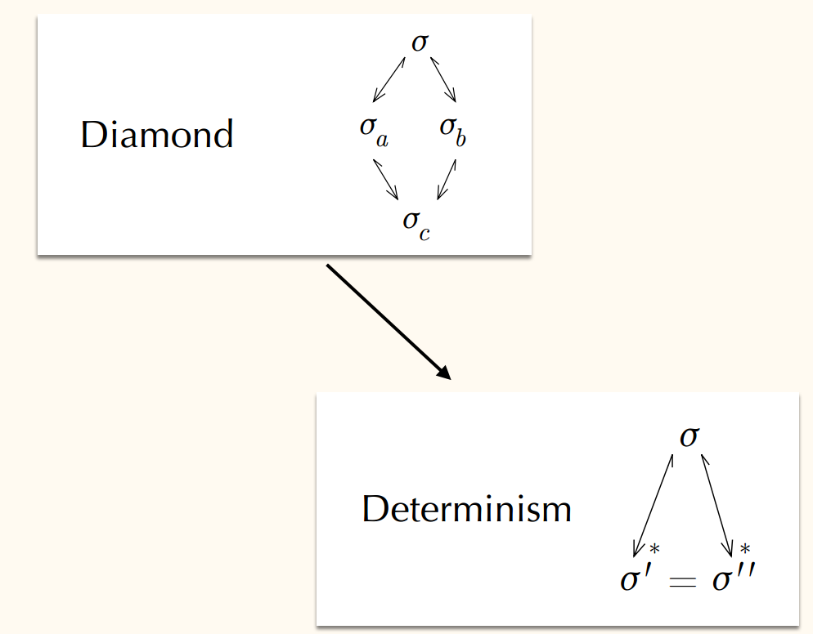
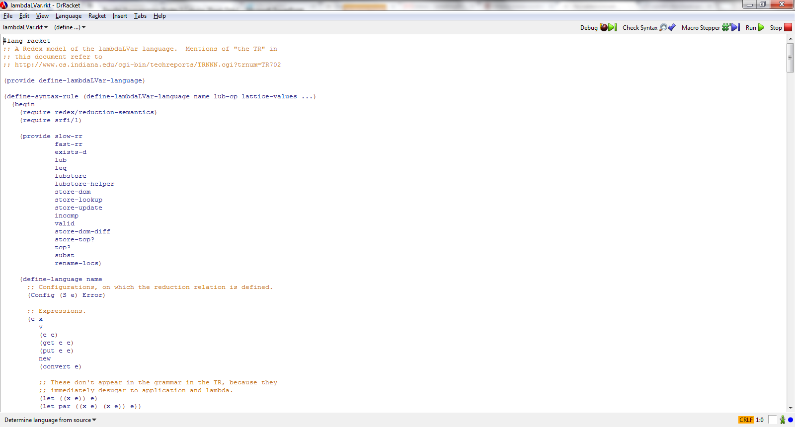

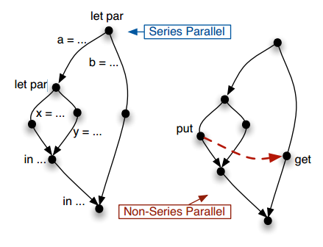
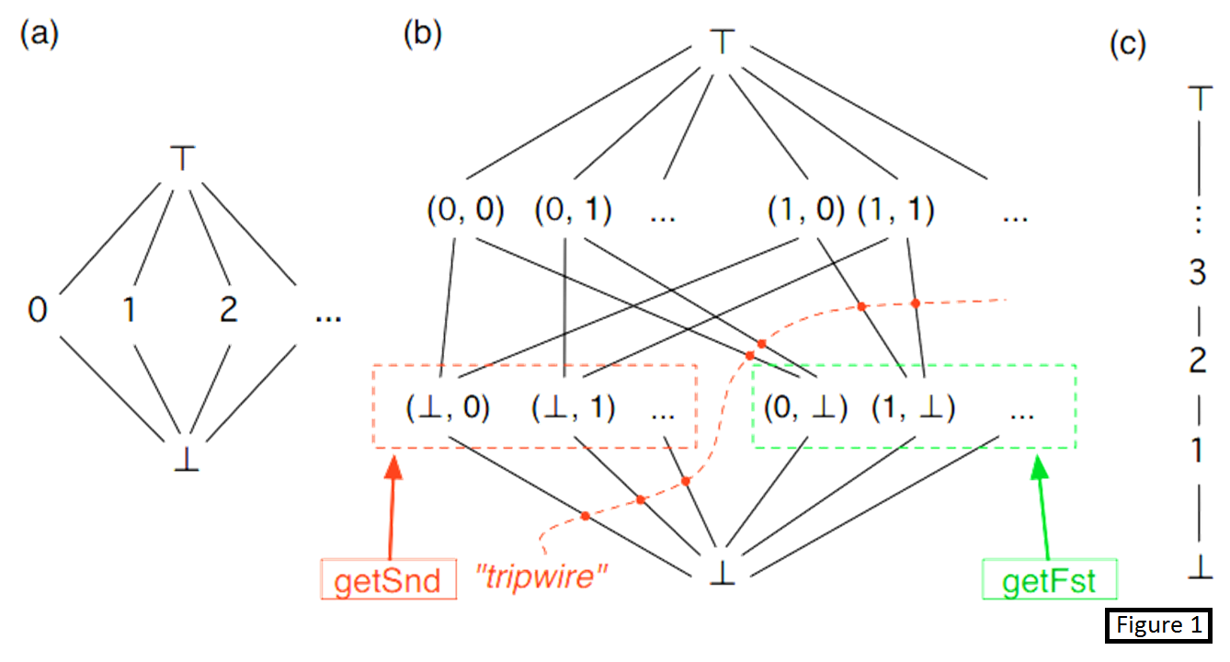

LVars for Parallel Programming
Isaiah Weating & Lindsey Kuper
School of Informatics and Computing - Indiana University
Introduction
Determinism for λ LVar
Determinism for λ LVar
Parallel programming is a form of computation in which multiple calculations are carried out simultaneously, operating on the principle that large problems can often be divided into smaller ones, which are then solved concurrently. This allows programs to operate faster. Parallel programming without state isn’t that difficult. When you add state to the equation though, it begins to get more challenging. This begins to cause the program to become nondeterministic depending on the order of the parallel computations. A nondeterministic program could have different solutions dependent on the order which statements are called. Our goal is to create a language that will allow a program to run various operations in parallel while still remaining deterministic.
Figure 2
Figure 3 shows two different parallel program flow charts. The one on the left will always be deterministic since the puts and gets are done separately. The one on the right though will be nondeterministic since the put and get are evaluated in parallel. Even though the program seemingly operates simultaneously, it actually does the operations separately in a random order depending on what the system decides to do first. This could cause problems if the system decides to operate the get before the put.
Tools Used
We developed our language in Reddex. Reddex is a programming language used for creating programming languages which is embedded in the racket language. Our development software of choice was Dr. Racket, shown below.
The Problem
This is the part where I talk about determinism in our program based on figure 2.
Before I began working on this project, there was already an implementation of the counter lvar, figure 1c. The counter lvar keeps track of the max value that has been entered. If the user were to put in values x and y into the lvar, it would keep track of max( x, y ). If the user were to then use the get function on any value that is less than or equal to max( x, y ), it would return true. If they were to call get with a value greater than max( x, y), it would return false.
The pair lvar, figure 1b, allows for pairs of values. This lvar only allows for one value in each index. The order in which the program puts in the values isn’t important. This lvar will also allow for inputting both values in parallel. Once it has both values assigned, if the program would attempt to put another value it, the lvar would reach top which would throw an error. Being able to implement this lvar is on way of solving our problem of keeping a parallel program deterministic.
let par a = ... let par x = ... y = ... in ... b = ... in ...
let par a = ... let par x = ... Put(l) ... y = ... in ... b = ... Get(l) ... in ...
Figure 3
Future Work
Info written by Lindsey
Contacts
Isaiah Weating --- iweating@indiana.edu
Lindsey Kuper – lkuper@cs.indiana.edu

